Slide 1

College Admissions
Ara Emerzian, Ian Cueli, Lasya Ganti, Rakesh Eleti, Jensen Dole

Slide 2
Introduction
Our team decided to focus on the Undergraduate Admission process for our UML Diagram Project. Our team focused on the general college admissions process through the application portal. Our process begins with an applicant submitting the needed requirements that the University requests. The University will receive the applicant's information. The admission office would review applicant’s information and decide the applicant’s status based on the Universities specific requirements. We represented these processes with functional diagrams, structural diagrams, and behavioral diagrams.

Slide 3
System Requirements
System Requirements
List of Business Activities
1) An applicant uploads required information into application portal.
2) University Admission Office receives information from applicant and verifies information and ensures all needed documents are included.
3) Admissions office processes initial information and makes initial cuts based on pre-determined statistics and academic requirements.
4) Initial cuts are made from academic requirements. Applicants are placed in buckets on whether they are moved forward or rejected based on initial determinants.
5) Secondary cuts are made through holistic and essay review.
7) Applicants are placed in final decision buckets: accepted, rejected, or waitlisted.
8) Admissions office prepares email list to be sent to applicants.
9) Emails are sent to applicants with the decisions and financial aid availability.
10) Applicants receive their decisions and can also check application status on portal.
6) Applicants will go through an interview process.

Slide 4
UML Diagrams
Functional Diagrams
Use Case Diagram
Use Case Description
Structural Diagrams
Class Diagram
CRC Card
Behavioral Diagrams
Sequence Diagram
Activity Diagram
Behavioral State Model

Slide 5
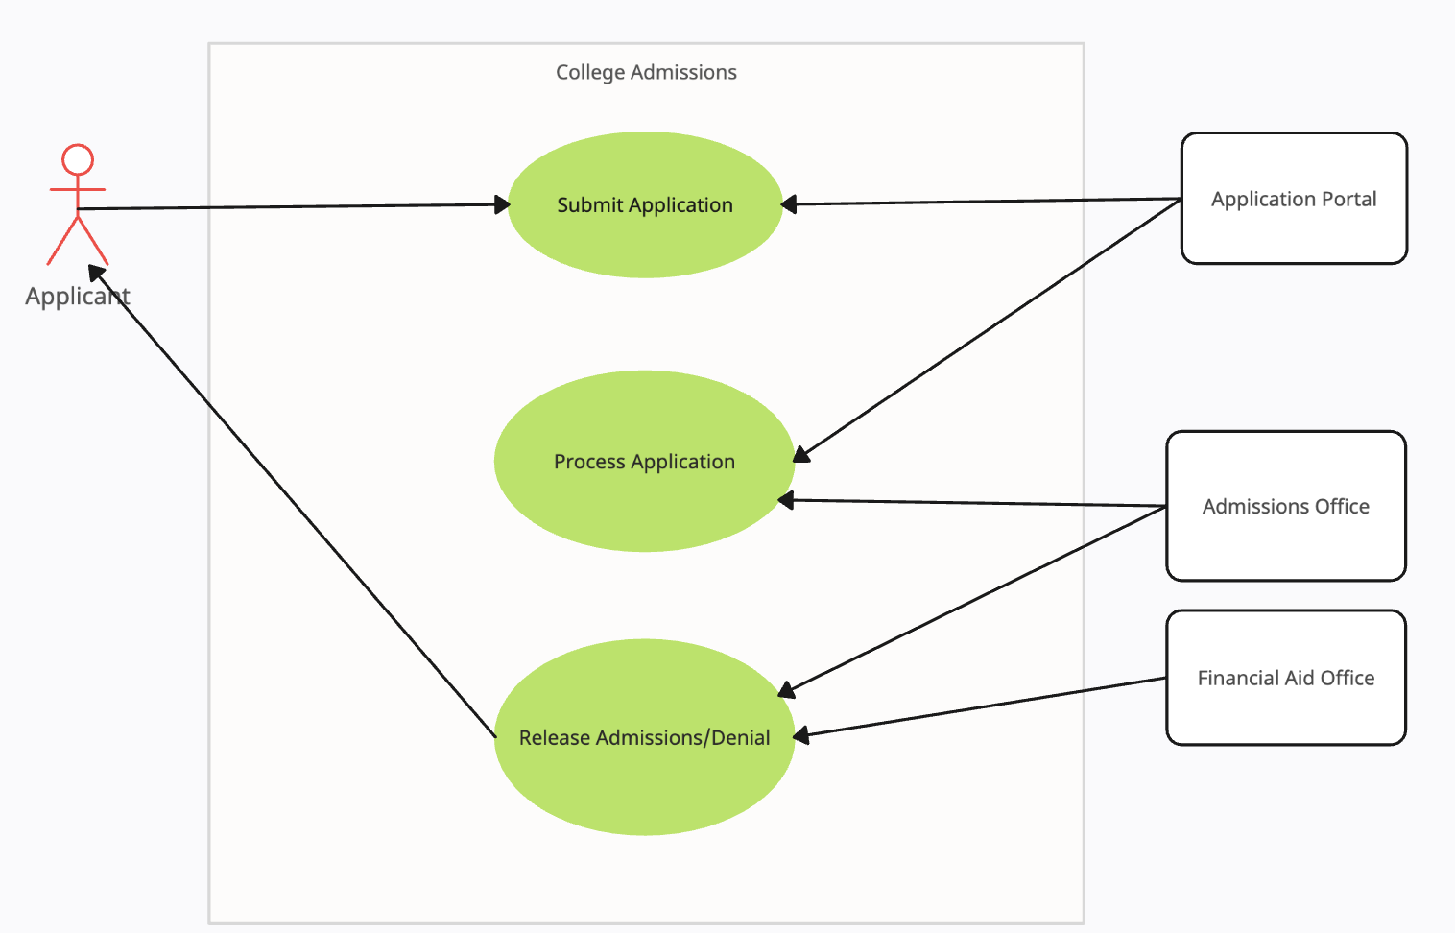
Use Case Diagram

Slide 6
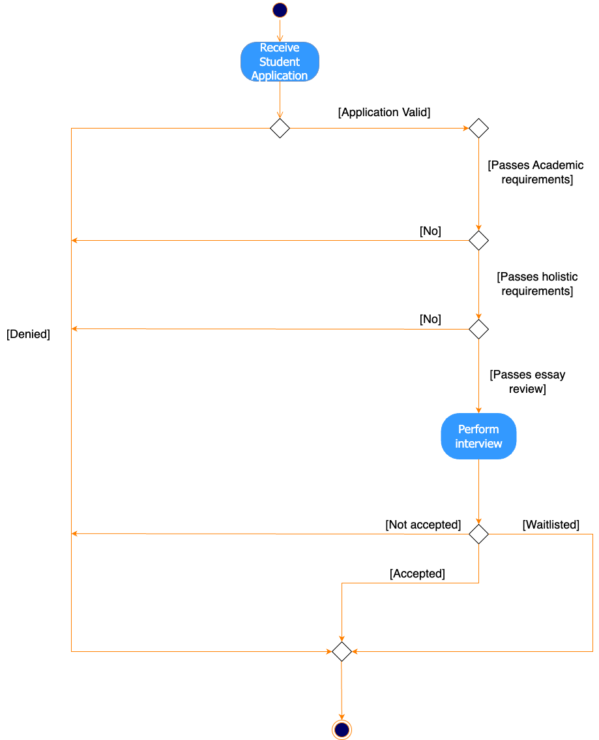
Activity Diagram

Slide 7
Use Case Description
Overview Information
Use case name: Process Application
Use case ID: 2
Use case type : detail, essential
Primary actor: Admissions Office
Importance level: High
Stakeholders: Students and Admissions Office
Students - want to be accepted into the University of Florida
Admissions Office - wants to ensure the university has a strong freshman class
Trigger: Student applies for admission

Slide 8
Use Case Description: Flow
Normal Flow of Events
1. Students send in applications to the application portal with all specified documents.
2. The university receives students' applications from portal.
University checks if the application is valid - perform S.1
3. The university begins the application review process
The application is sent through the initial academic requirements.
3.a If the student makes it through the initial requirements- perform S.2
3.b If the student doesn't make it through initial requirements
3.b.1 Students are denied
4. The applications go through a final round
Applications are reviewed after the interview stage
4.a.1 Students are accepted
4.a.2 Students are rejected
4.a.3 Students are waitlisted
5. Students are placed into email buckets that are waiting to be sent out to students
6. Send decisions and financial aid availability out to applicants via email.
Sub Flow
University checks if the application is valid
S.1.A The student’s qualifications match with the university requirements, go to 3
S.2.B If invalid, students are rejected
Student passes initial requirements
S.2 Students are run through holistic review requirements
S.2.A If accepted, perform S.3
S.2.B If they do not pass, students are rejected
S.3 Students are run through essay review
S.3.A If they pass, go to 4
S.3.B If they do not pass, students are rejected

Slide 9
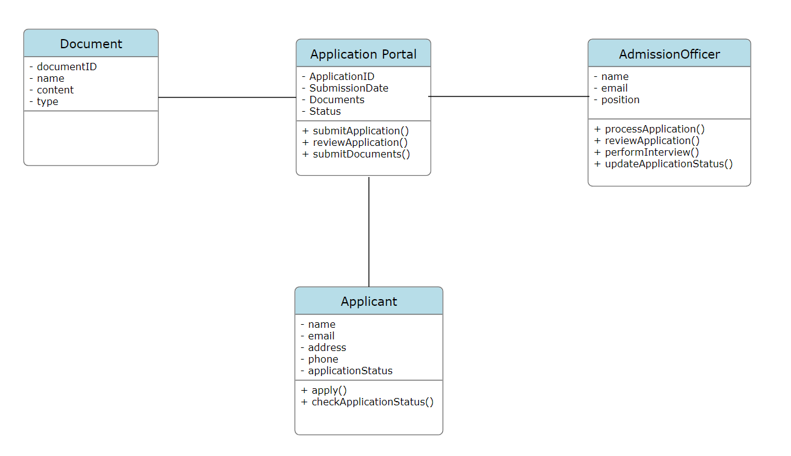
Class Diagram

Slide 10
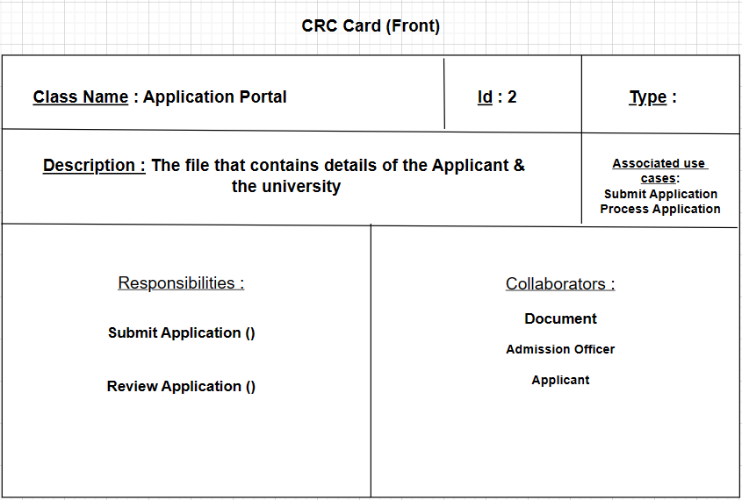
CRC Card (Front)

Slide 11
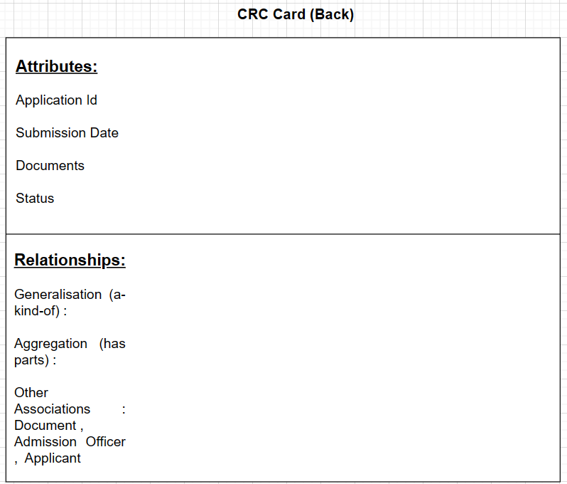
CRC Card (Back)

Slide 12
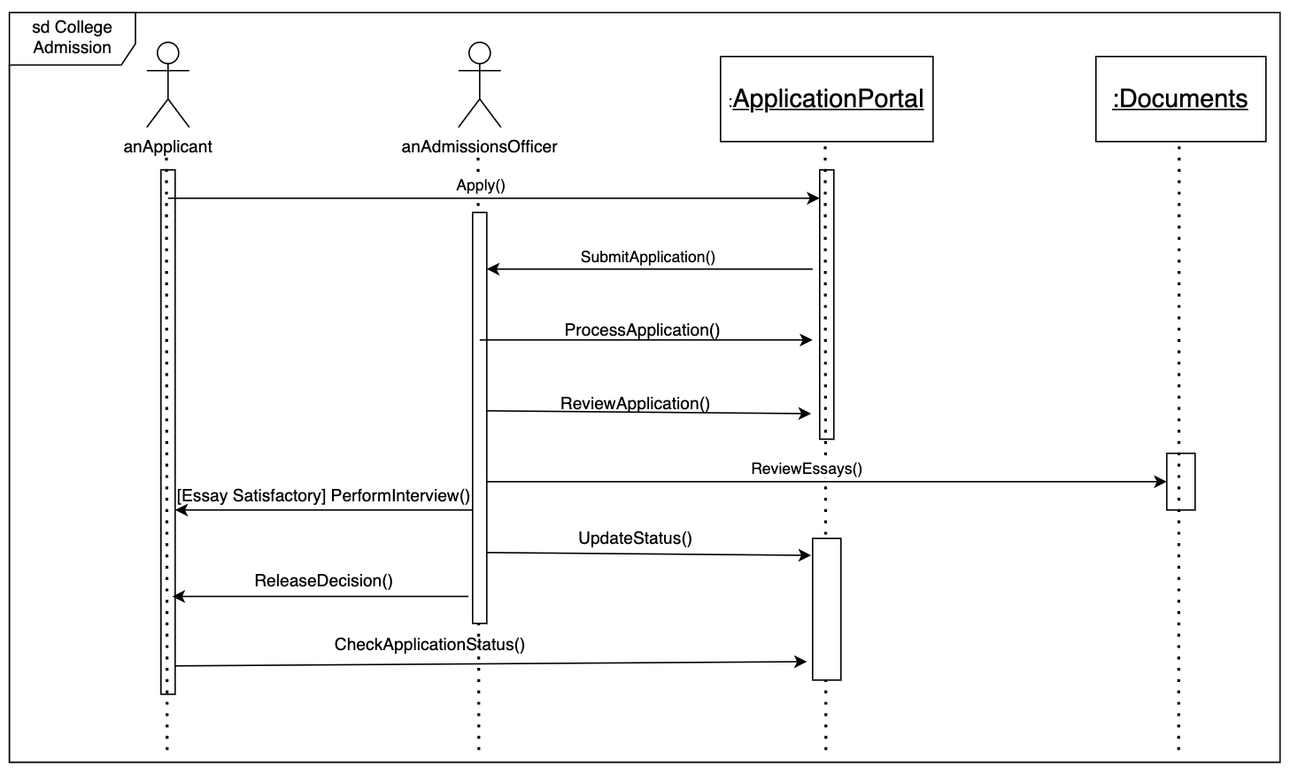
Sequence Diagram

Slide 13
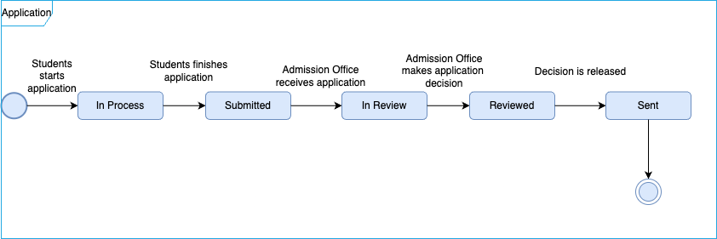
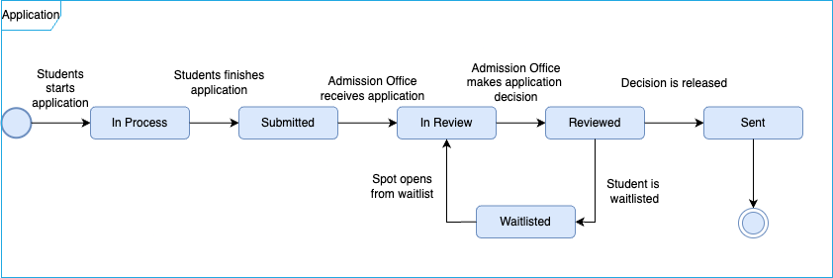
Behavior State Machine

